Slide 1
Timelines, TGA and System Verification
Logica per l’Informatica

Slide 2
Context & Motivations
Timeline-Based Planning has been shown effective in real world applications
Nevertheless, a limited investigation of its formal properties
We are investigating the integration of V&V and plan generation and execution
A recent initiative aims at providing a well founded formalization for planning & execution with timelines
This also opens the way for having results also on expressiveness and complexity
[Muscettola 94, Jonsson et al 2000, Frank & Jonsson 2003, Cesta et al 2008, etc]
[Cesta et al 2010, 2011, 2013, Orlandini et al 2014]
[Cialdea et al 2014, Cialdea & Orlandini 2015, Cialdea et al 2016]
[Gigante et al 2017, Gigante et al 2018]

Slide 3
Formalization of Flexible Timelines
Formal definition of
State Variables, Planning domains and Goals
Tokens/Timelines and Flexible Tokens/Timelines
Temporal Relations and Flexible Plans
Controllability issue included in the framework
Controllable and Uncontrollable tokens
Planned and External state variables
A formal equivalence between STNU and flexible plans
Definition of Dynamic Controllability for timeline-based plans
Timed Game Automata model checking for robust execution strategy synthesis
[Cialdea Mayer et al 2014]
[Cialdea & Orlandini 2015, Cialdea Mayer et al 2016]

Slide 4
Flexible Plan Controllability
A Flexible Plan (FTL,R) is
weakly controllable – if there is a viable execution strategy
Strongly controllable – if there is a viable execution strategy giving the same scheduling function for every situation
Dynamically controllable – if there is a dynamic execution strategy (DES) – decisions only considering past uncontrollable events
Dynamic controllability constitutes a highly desirable property for a flexible plan
[Cialdea & Orlandini 2015, Cialdea Mayer et al 2016]

Slide 5
Building Timed Game Automata from Timelines
Encoding a Flexible Plan (FTL,R) into a network of TGA
Each Timeline in FTL encoded by an automaton
Transition controllability is defined according to token’s controllability tag
Temporal relations as clocks constraints on transitions
Suitably defining a TGA Reachability Game (RG)
Winning the game implies checking DC for a flexible plan
UPPAAL-TIGA as verification engine
Winning strategy is a viable DES for the encoded plan
Encoding tool plan2tiga and details available at http://cialdea.dia.uniroma3.it/plan2tiga

Slide 6
TGA-based Controller synthesis with UPPAAL-TIGA
A Flexible plan (FTL, R) is encoded in an Uppaal-Tiga system
an Uppaal-Tiga process in N models a timeline FTLx ∈ FTL, every token of FTLx is modeled by a location
A final state, called finish, is reached at the end of the timeline
Uppaal-Tiga checks a pure reachability property,
A<>(Ax1 .finish ∧ · · · ∧ Axk .finish)
where N = {Ax1 , . . . , Axk }, whichever the behaviour of uncontrollable components, N can reach their final states

Slide 7
Building TGA from Timelines
A mapping into Timed Game Automata
Tokens for Locations
One local clock + one general clock (plan clock)and
Token temporal information for Guards/Invariants
Token sequence for Transitions
The Network of TGA represent FTL
A set of variable and constraints represents R

Slide 8
Building TGA from Flexible Plan
Given a Flexible Plan (FTL,R) we define a TGA for each timeline FTL_{x} in FTL
Guards:
Invariants:
On start and end, guards/invariants set to 0/H
R
q₀
q₁
q₂
q₃
q₄
Start
P
Q
P
R
End
0
tp₁
tp₃
tp₄
tp₆
H
lb₁
ub₁
lb₂
ub₂
………
time
Considering a location for each token
Considering one general clock clock_plan and one local clock c_{x}
Considering Inv(q_{i}) = c_{p} ≤ ub_{i}
Considering a guard c_{p} ≥ lb_{i} for each transition

Slide 9
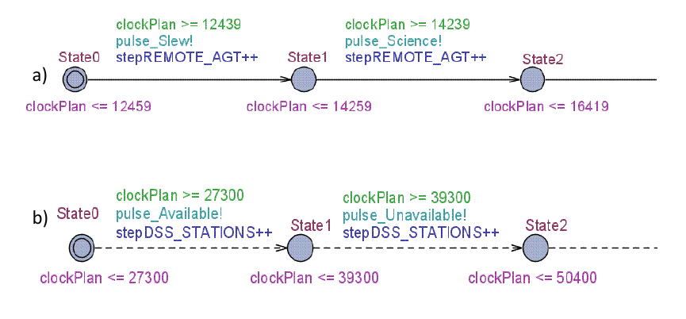
Building TGA from Flexible Plan

Slide 10
Encoding relations
Relations among a token and a time point
Set a guard constraint over the general clock e.g., x^{i} start_before_{[lb,ub]} t is encoded adding a guard plan_clock ≤ t – lb and plan_clock ≥ t – ub to edge entering the location x^{i}
Relations between two tokens
Define a clock and set guard constraints e.g., x^{n} start_before_start[lb,ub] y^{k} is encoded with clock_R assigned the value H on edge entering location x^{n} and guards associated to R H + lb ≤ clock_{R} and clock_{R} ≤ H + ub placed on edge entering the location y^{k}

Slide 11
Tiga2Exec a new tool for Plan Execution
[Lanzilli et al. 2019]
A new tool for executing flexible plans via dynamic execution strategies
Plan2Tiga to encode plan as TGA
UPPAAL-TIGA to verify plans, check DC and generate DES
Represent DES to provide a P&S system with a robust plan execution strategy
Can be integrated with any timeline-based P&S system compliant with [Cialdea et al 2016] al formalization
Currently integrated within PLATINUm
[Umbrico et al. 2017, Umbrico et al 2018]

Slide 12
Tiga2Exec at Work
DDL
Planner
<<PLATINUm>>
2.3b. No DC strategy found
PDL
1. plan synthesis
3. plan execution
Plan
2. DC strategy generator
Tiga2Exec
2.1. TGA mapping
*.2. Strategy check
Strategy
Manager
Plan2Tiga
Executive
<<PLATINUm>>
DC
Strategy
2.2. DC property check
*.3. Strategy actions
UPPAAL-TIGA
*.1.
Execution
Feedback
*.4.
Token
Dispatching
2.3a. DC strategy extraction

Slide 13
Empirical Evaluation
To investigate the practical feasibility of the TGA-based approach (online)
Test the performance of verification, strategy generation and strategy management
A benchmarking problem inspired by a Space Long-Term Mission Planning problem

Slide 14
The benchmark domain
A generic space domain derived from MrSPOCK’s LTP problem
A remote space agent is to be controlled to accomplish some required tasks
Different Domain versions with increasing complexity
Slew
Spacecraft
Operative Mode
Comm
Maint
Comm
Sc
[Cesta et al. 2010]
Warmup
Process
Turnoff
DURING
Device
DURING
DURING
MAD
Unavailable()
Available
(151.300,ul_dl,70m)
Unavailable()
Ground Station
Availability
Timelines
CEB
Available
(91.400,dl,34m)
Unavailable()
NNO
time

Slide 15
Experimental Results
Different scenarios and execution contexts addressed
Goal requests, determining the complexity (# of tokens) in the timelines
Temporal uncertainty, determining the width of the time intervals constraining the duration of uncontrollable activities [10 – 30 seconds]
Increasing Temporal Horizon for achieving scientific goals
Problems with higher number of goals and larger temporal uncertainty are the hardest ones

Slide 16
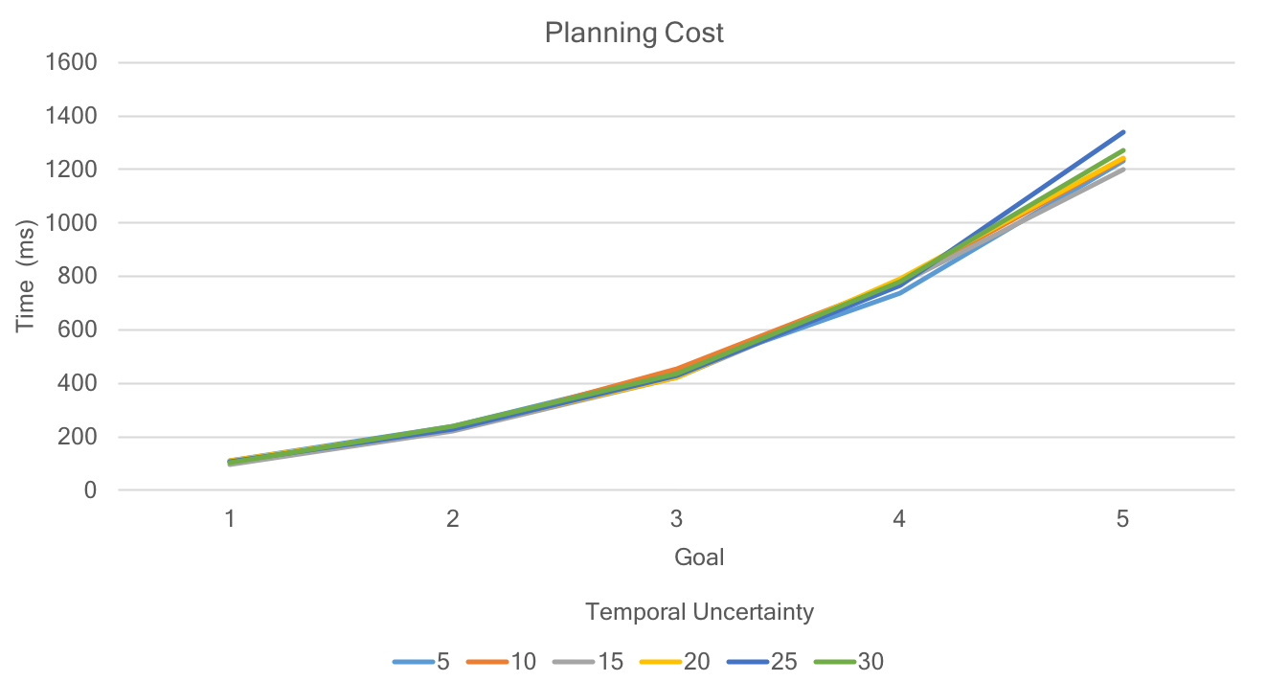
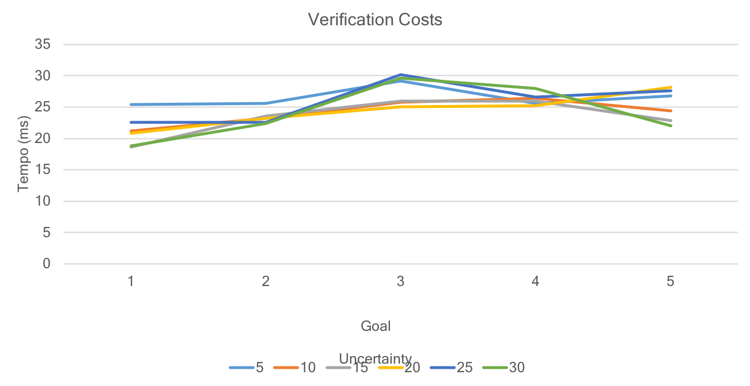
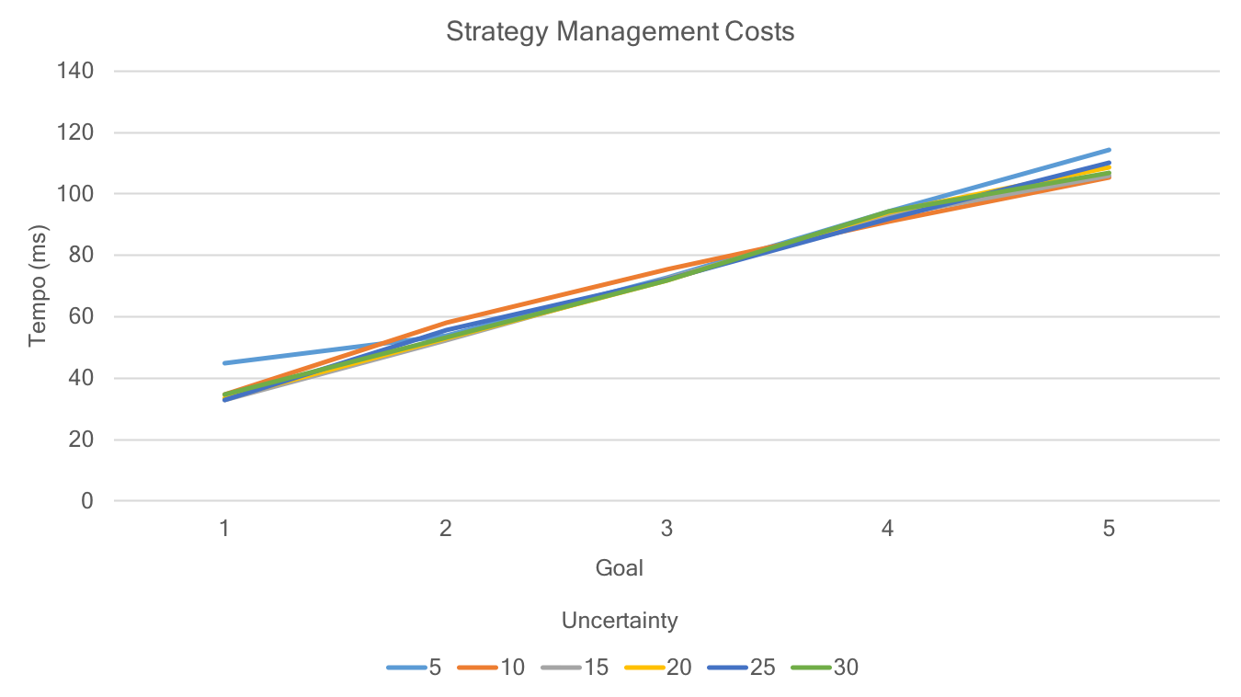
Initial Experimental Results
Rigid plans entail brittle execution
Verification and Strategy management latencies compatible with planning costs
Tiga2Exec successfully execute plans when DES is available

Slide 17
Verification and Validation meet Planning and Scheduling
AndreA Orlandini
(CNR-ISTC)
Email: andrea.orlandini@istc.cnr.it
National Research Council of Italy (CNR-ISTC)

Slide 18
P&S Autonomy and V&V
P&S systems are finding increased application in mission safety-critical and dependable systems
Model-based autonomy to generate plans to control a plant, e.g., a spacecraft or a rover
A first relevant example in a real-world context
Remote Agent Experiment (RAX) for Deep-space 1 (DS-1) mission endowed with V&V technology – Livingstone (2001)
Nevertheless, tools and methodologies for V&V of P&S have received relatively little attention…
(Jonsson et al. AIPS 2001)

Slide 19
Verification and Validation
Verification: “Are we building/doing the thing right?”
The system should conform to its specification
Validation: “Are we building/doing the right thing?”
The system should do what the user really requires

Slide 20
A Generic Plan-based Controller
V&V
V&V
Software failure/semantic failure
Model fails to capture critical behaviour of physical system
V&V
V&V
Mismatch in action interpretation between model and executive
Physical system behaves unexpectedly – physical fault or world generates spurious event

Slide 21
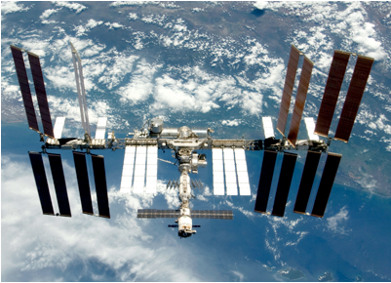
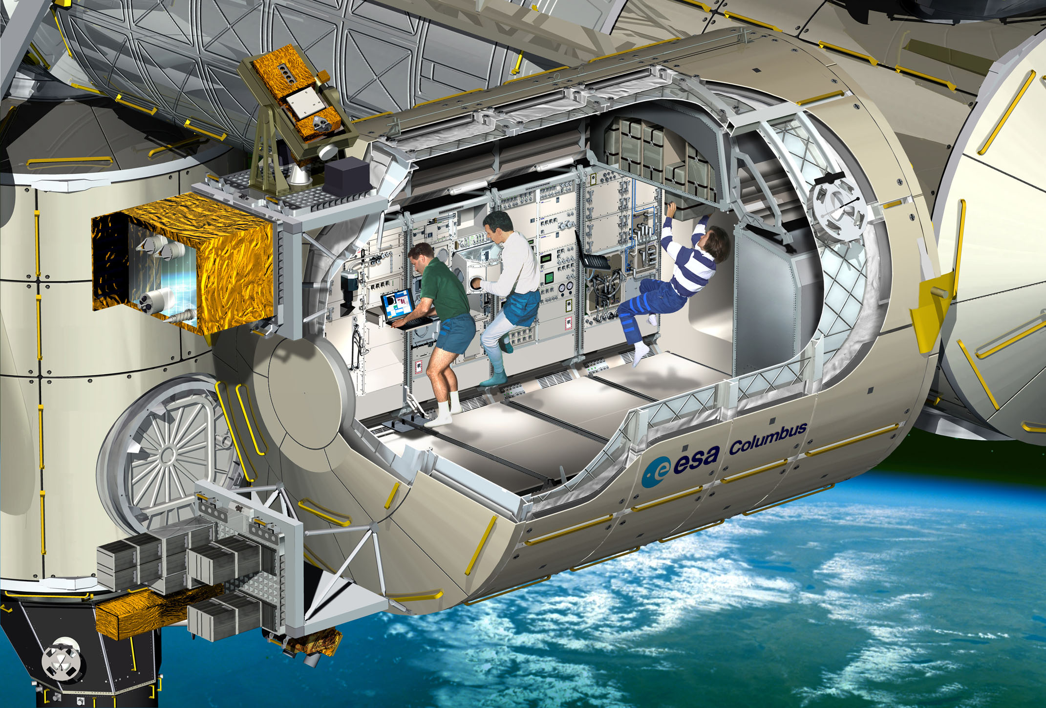
ULISSE, USOCs and Increment Planning Processes
ULISSE aims at improving preservation, valorization and exploitation of data produced by the Columbus module on board the ISS
USOCs are a network of scientific space facility operations centres
To produce a demonstrator we have targeted the ISS increment planning (usually a three months period)

Slide 22
A Generic Plan-based Controller
Plan Verification and Validation

Slide 23
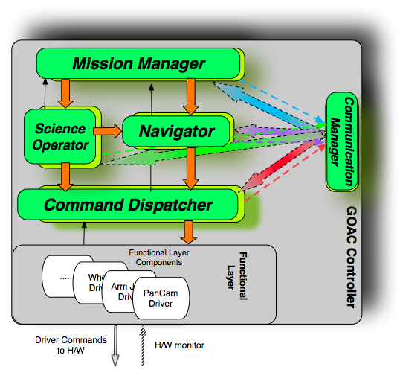
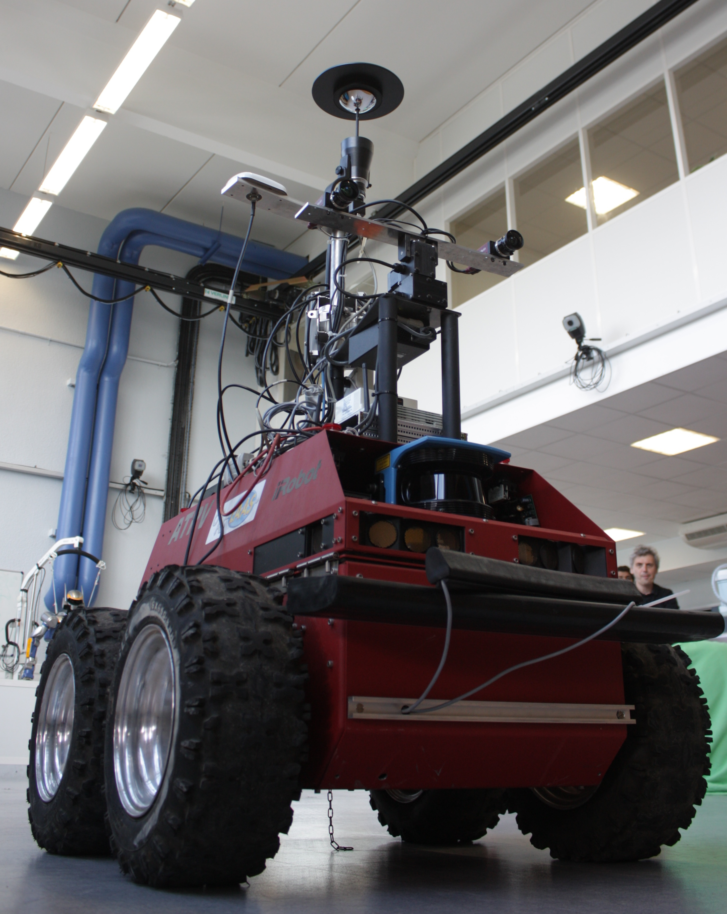
Goal Oriented Autonomous Controller (ESA ITT [2009-2011])
Aiming at creating a state of the art autonomous controller for ESA’s space rovers
Consortium: GMV (Spain), LAAS (France), Verimag (France), MBARI (USA), CNR-ISTC (Italy)
Deliberative layer based on timeline-based planning and execution
GOAC

Slide 24
A Generic Plan-based Controller
Plan Controllers synthesis

Slide 25
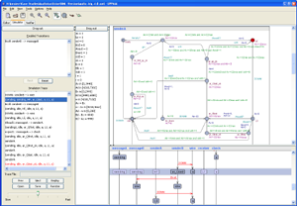
APSI-TRF and Knowledge Engineering ENvironment (KEEN)
KEEN Design Support System
Domain/Problem Editing & Visualization
Plan Editing & Visualization
Plan Execution
Validation
APSI-TRF
Plan Execution
Problem
Description
Language
Component
Based
Modeling
Engine
Dispatch
Services
Domain
Description
Language
Current Plan
Execution
Feedback
Problem Solver
Domain
Validation
TGA
Encoding
Planner Validation
TIGA
Plan
Verification
Plan
Validation
[Orlandini et al 2014]

