Slide 1
Covert Channel for One-Way Delay Measurements
Mario Cola
Giorgio De Lucia
Daria Mazza
Maurizio Patrignani
Massimo Rimondini
18th International Conference on Computer Communications and Networks (ICCCN)
August 4th, 2009

Slide 2
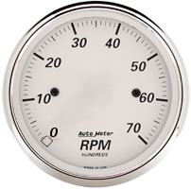

Scenario
customer site 2
customer site 3
CE
CE
customer site 1
PE
PE
CE
PE
ISP
(MPLS backbone)
customer
PE
PE
CE
CE
customer site 5
customer site 4

Slide 3
State of the Art
Measurement System
Ideal
✓
✗
✗
✗
✗
Active | Passive
1-way measures
Intrusive
Probes⬄Accuracy
✓
✓
✓
✓
✓
✗
✗
✗
Control packets
  sync, negotiation, aggregate results
Probe packets
Traffic sampling
Out-of-band ch.
✓ | ✗
✗ | ✓
Cisco IP-SLA,
Juniper RPM,
H3C HWPing
Ipanema patent,
Distributed infrastr. [Arlos05]
C API [Harfoush02]
IPMP [Luckie02]
Pathload [Jain02]
NLANR AMP,
CAIDA Archipelago,
OWAMP
CAIDA reports & traces (CoralReef),
Sprint IPMON
Lossy Difference Aggregation [Kompella09]
Notes:
Cisco IP SLAs: http://www.cisco.com/en/US/tech/tk920/tsd_technology_support_sub-protocol_home.html
Juniper RPM (Real-Time Performance Monitoring): http://www.juniper.net/techpubs/software/junos/junos74/swconfig74-services/html/rpm-overview.html
H3C HWPing: http://www.h3c.com/portal/Technical_Support___Document/Technical_Documents/Switches/H3C_S7500_Series_Switches/Configuration/Operation_Manual/H3C_S7500_Series_OM-(Release_3100_Series)-(V1.01)/200701/197399_1285_0.htm#_Toc147316360
Pathload: http://www.cc.gatech.edu/fac/Constantinos.Dovrolis/bw-est/pathload.html
CAIDA also has passive monitors (e.g., for the PREDICT project that supports network and security data collection)
NLANR = NSF National Laboratory for Applied Network Research; AMP (Active Measurement Project) has been shut down in 2006

Slide 4

Our Contributions
A measurement architecture
  passive
  nonintrusive
  no sampling
  unaffected by lost or
  out-of-sequence packets
A formal establishment
of measurement accuracy
Experimental evalution
Notes:
passive: no probe packets
nonintrusive: no packets to exchange measurement information
no sampling: all the traffic is measured

Slide 5



Covert Channel
info
Embedding covert channels into TCP/IP [Rowland97,Murdoch05]
data
data
We exploit unused bits of the IP header
to measure the OWD

Slide 6
customer site 2
customer site 3
CE
CE
customer site 1
PE
PE
CE
PE
ISP
(MPLS backbone)
PE
PE
CE
CE
customer site 5
customer site 4

Slide 7
Architecture
customer site 2
MA
customer site 1
MA
customer site 3
CE
CE
CE
MA
PE
PE
PE
ISP
(MPLS backbone)
MA
MA
PE
PE
CE
CE
customer site 5
customer site 4

Slide 8
Measurement Agents
Upstream component
MA
receive packet
store & forward
MA
...a different site of...
directed to same customer?
CE
YES
encode timestamp
NO
forward packet

Slide 9
Measurement Agents
Downstream component
MA
receive packet
cut through
...a different site of...
coming from same customer?
YES
decode timestamp
NO
compute aggregates
forward packet

Slide 10
Measurement Agents
QoS between different customers X, Y connected to the same backbone
MA
directed to same customer?
directed to customer X?
coming from same customer?
coming from customer Y?

Slide 11


Digging the Covert Channel
Usable bits
  not used by ES for critical functions
  not altered by IS
If customers rule out fragmentation...
  identification (16 bits)
  don’t fragment (1 bit)
IP*
  Sec: ☺ ESP, 😐 AH
  v6: 😐
(✓ ok with MPLS)
  reserved (1 bit)
  fragment offset (13 bits)
  ttl
  (some of 8 bits)
  type of service
  (8 bits)
Notes:
ttl: 8 bit

Slide 12
Measurement Errors
Minimize (or, at least, watch) error on:
Measurement
Margin of error
Confidence level
actual one-way delay
computed one-way delay

Slide 13
Measurement Errors:
Quantization Error
(Max) sync offset
Measure scale
2
αδ
1
0
0
0
upstream component
quantization error
downstream component
Notes:
The quantization error can be assumed uniformly distributed because packet arrival times are not related with the local clock
e_qu and e_qd may also be correlated (the convolution would exhibit a different shape, but this does not change the following results)

Slide 14
Measurement Errors:
Saturation Error
Available bits
Timestamps represented
modulo
bits
A₁
A₁
0
0
0
0
0
error=0
error=k
A₂
A₂
1
1
1
1
1
error=2k
A₃
0
0
0
0
0
A₃
0
0

Slide 15
Measurement Errors:
Overall Error
e₁ and e₂ are statistically independent
A₁
A₁
A₂
A₃
0

Slide 16

Measurement Setup (1)
MAs synchronized with precision
User specifies , , and , requesting that
,
Configure MAs with , , and source & destination addresses
while
guaranteeing that
Theorem. Let be such that and is minimized.
Then, for we have .
Notes:
In realtà l’utente non DEVE garantire il max delay. Ma, se lo fa, allora può essere sicuro che la misura sia nell’ambito dell’errore richiesto

Slide 17
Measurement Setup (1):
Example
In human words:
user requires
and estimates that 99.9% of the packets have delay less than 1000ms

Slide 18
Measurement Setup (2)
Alternative scenario:
  User provides and and has a constraint on
Alternative scenario:
  User provides , , and
  Requirements are satisfied if

Slide 19

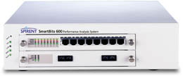
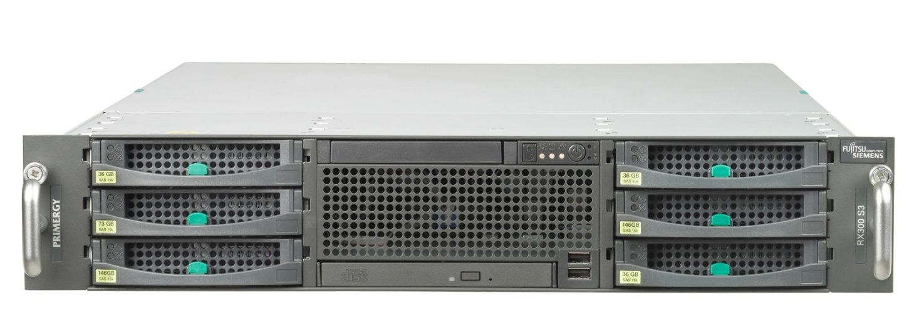
Experimental Setup
GE
Traffic generator & analyzer
MA1
(upstream component)
tg_ge0
ma1_ge0
GE
Network impairment
ma1_ge1
Spirent SmartBits SMB600B
ni_ge0
Fujitsu Siemens Primergy RX300
Dual Quad-Core Intel Xeon 5000, 8GB RAM
2 dual-port GE NICs
ni_ge1
GE
Netem
MA2
(downstream component)
ma2_ge0
tg_ge1
GE
ma2_ge1

Slide 20
Experiment 1:
Validation
14,000 packets of 896 bytes each
bandwidth utilization: 70%
variable delays
(uniform distribution)
and
guarantee on the delay
deduced by the network
impairment configuration
input
Notes:
Dalla documentazione di Netem:
Real wide area networks show variability so it is possible to add random variation.
# tc qdisc change dev eth0 root netem delay 100ms 10ms
This causes the added delay to be 100ms ± 10ms. Network delay variation isn't purely random, so to emulate that there is a correlation value as well.
Fonte dell’informazione sulla uniform distribution: http://www.myminimaxwell.com/support/mini-maxwell-user-guide/menu-id-2.html

Slide 21
Experiment 1:
Validation
P=0.001
transmission delay of the downstream component
limited by transmission delay of the downstream component
Exp. ID | Delay (ms) | T (μs) | B | Freq. e>T
1 | 30 ± 10 | 200 | 9 | 0.0006
2 |  |  |  | 0.0002
3 |  |  |  | 0.001
4 |  | 500 | 8 | 0
5 |  |  |  | 0.0003
6 |  |  |  | 0
7 |  | 1000 | 7 | 0
8 |  |  |  | 0
9 |  |  |  | 0
10 |  | 2000 | 6 | 0
11 |  |  |  | 0
12 |  |  |  | 0
Exp. ID | Delay (ms) | T (μs) | B | Freq. e>T
13 | 60 ± 10 | 200 | 10 | 0.0016
14 |  |  |  | 0.0001
15 |  |  |  | 0.0009
16 |  | 500 | 9 | 0.0002
17 |  |  |  | 0
18 |  |  |  | 0.0001
19 |  | 1000 | 8 | 0.0001
20 |  |  |  | 0
21 |  |  |  | 0.0001
22 |  | 2000 | 7 | 0
23 |  |  |  | 0
24 |  |  |  | 0
Notes:
Effettuare altri esperimenti con range di delay più ampi?

Slide 22
Experiment 2:
Performance
owd computed @ downstream component
Delay: 60±10ms
Meas. time span: 20s
nic queue saturation

Slide 23
Experiment 2:
Performance
Bandwidth: 90%

Slide 24
Experiment 3:
Latency
No network impairment
Delays collected by SMB
switching overhead
MA
CE
Notes:
The latency is partly due to the transmission delay (only relevant if the MA is *not* implemented on a CE)

Slide 25

Experiment 4:
Throughput
No network impairment
100% bandwidth utilization
Varying packet size (until
first dropped)
With disabled MAs:
With enabled MAs:
5.24% reduction
265,957 pkts/s
450 bytes long
252,016 pkts/s
476 bytes long
Notes:
Spiegare bene come è calcolato il throughput (pacchetti di dimensioni diverse finché non si ha il primo pacchetto perso)

Slide 26

Conclusions and Future Work
Take away
  IP covert channel for OWD measurements is feasible
  Formal analysis of measurement errors
What next
  Different techniques to exploit the covert channel
  Different kinds of measurements

