Slide 1
Towards an Automated Investigation of the Impact of BGP Routing Changes on Network Delay Variations
Massimo Rimondini
Claudio Squarcella
Giuseppe Di Battista
Passive and Active Measurement Conference (PAM 2014)
March 11th, 2014

Slide 2



BGP Routing Changes
Notes:
Collector peers => BGP vantage points

Slide 3


Network Delay Variations
132ms
42ms

Slide 4
Towards an Automated Investigation of the Impact of BGP Routing Changes on Network Delay Variations
Massimo Rimondini
Claudio Squarcella
Giuseppe Di Battista
Passive and Active Measurement Conference (PAM 2014)
March 11th, 2014

Slide 5
“Impact”
132ms
42ms

Slide 6




Motivations
SLAs
QoE
$

Slide 7





Motivations

Slide 8
Motivations
vs

Slide 9
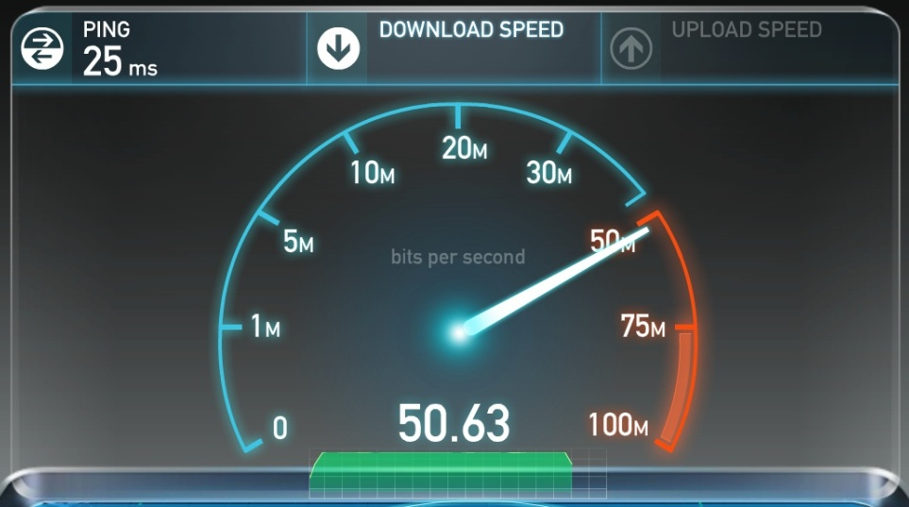
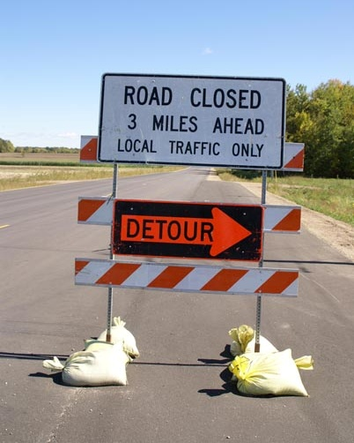

Motivations

Slide 10


Motivations
(and Applications)

Slide 11
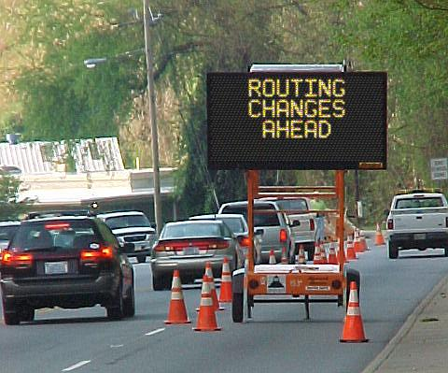
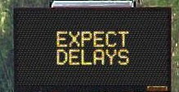

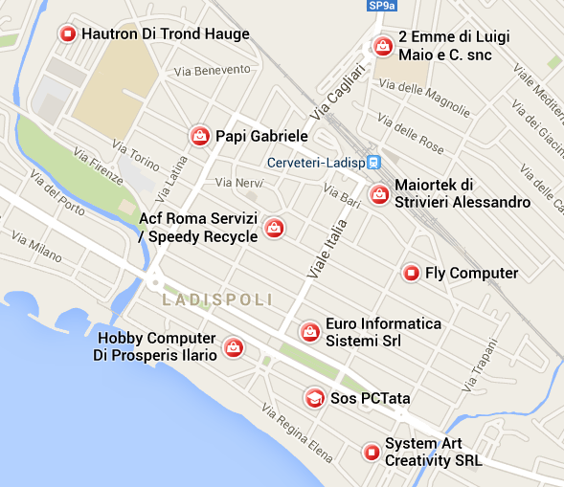
Motivations
(and Applications)
Oh, no! I’m sensitive to delay!

Slide 12


Motivations
(and Applications)

Slide 13
Towards an Automated Investigation of the Impact of BGP Routing Changes on Network Delay Variations
Massimo Rimondini
Claudio Squarcella
Giuseppe Di Battista
Passive and Active Measurement Conference (PAM 2014)
March 11th, 2014

Slide 14
Our Contributions
Methodology
  Determines if a routing change caused a significant RTT variation
  Statistical methods
Application
  RIPE RIS + RIPE Atlas
  Test in the wild
A-posteriori statistics
Automated Investigation of the Impact of BGP Routing Changes on Network Delay Variations

Slide 15
State of the Art
Pucha, H., Zhang, Y., Mao, Z., Hu, Y.: Understanding network delay changes caused by routing events. Proc. SIGMETRICS 2007
Routing changes cause delay variations
  as opposed to congestion
  average delays mostly impacted by interdomain changes

Slide 16
State of the Art
Chuah, C.N., Bhattacharyya, S., Diot, C.: Measuring I-BGP updates and their impact on traffic. Tech. Rep. TR02-ATL-051099, Sprint ATL 2002
Wang, F., Mao, Z.M., Wang, J., Gao, L., Bush, R.: A Measurement study on the impact of routing events on end-to-end internet path performance. SIGCOMM Comput. Commun. Rev. 36(4), 375–386, 2006
Zhang, Y., Mao, Z., Wang, J.: A framework for measuring and predicting the impact of routing changes. Proc. INFOCOM 2007
Routing convergence can cause performance degradations

Slide 17
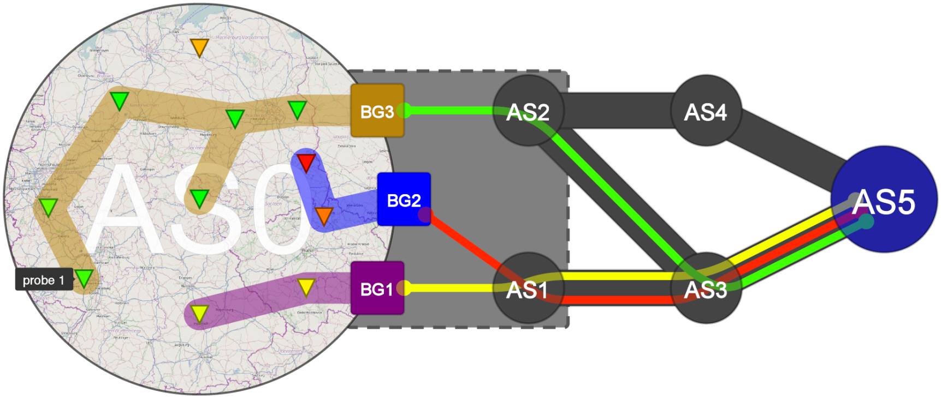
State of the Art
Da Lozzo, G., Di Battista, G., Squarcella, C.: Visual discovery of the correlation between BGP routing and round-trip delay active measurements. Computing, 1–11, 2013
Focus on the graphical metaphor

Slide 18
State of the Art
Mahimkar, A., Ge, Z., Wang, J., Yates, J., Zhang, Y., Emmons, J., Huntley, B., Stockert, M.: Rapid detection of maintenance induced changes in service performance. Proc. CoNEXT 2011
Mahimkar, A., Song, H., Ge, Z., Shaikh, A., Wang, J., Yates, J., Zhang, Y., Emmons, J.: Detecting the performance impact of upgrades in large operational networks. Proc. SIGCOMM 2010
Identify patterns in performance changes
  statistical rule mining
  network configuration information

Slide 19
State of the Art
Tsamoura, E., Gounaris, A.: Incorporating change detection in network coordinate systems for large data transfers. Proc. PCI 2013
Predict network delay between host pairs
  change detection algorithms

Slide 20
Scenario

Slide 21
Methodology – Overview
Penalty
Changepoint analysis
Time window
Time shift
Elbow slope threshold
Probe ID
Target
Raw RTT measurements
Preprocessing
Time alignment
Changepoint detection
BGP updates
Preprocessing
Matching
Prefix
Tolerance window
Correlation
Time window
Collector peer

Slide 22
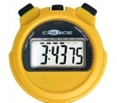


Methodology – Parameters
Data set | Correlation tuning
Time window | Time shift
Probe ID | Elbow slope threshold
Target | Penalty
(BGP) Prefix | Tolerance window
Collector peer

Slide 23
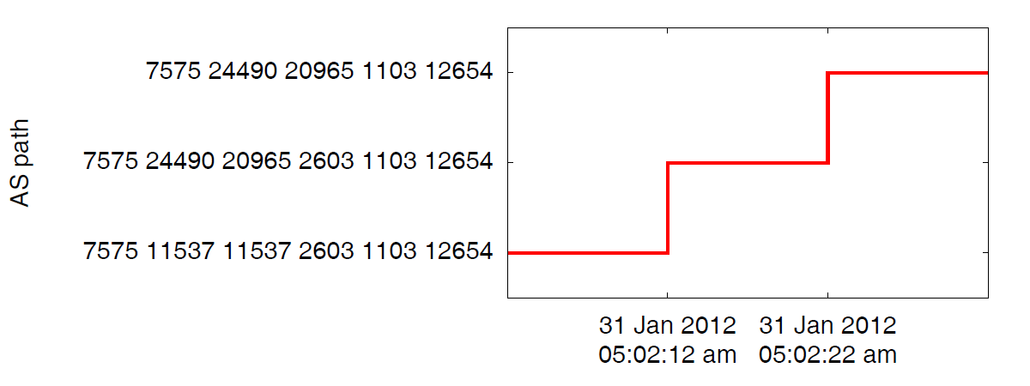
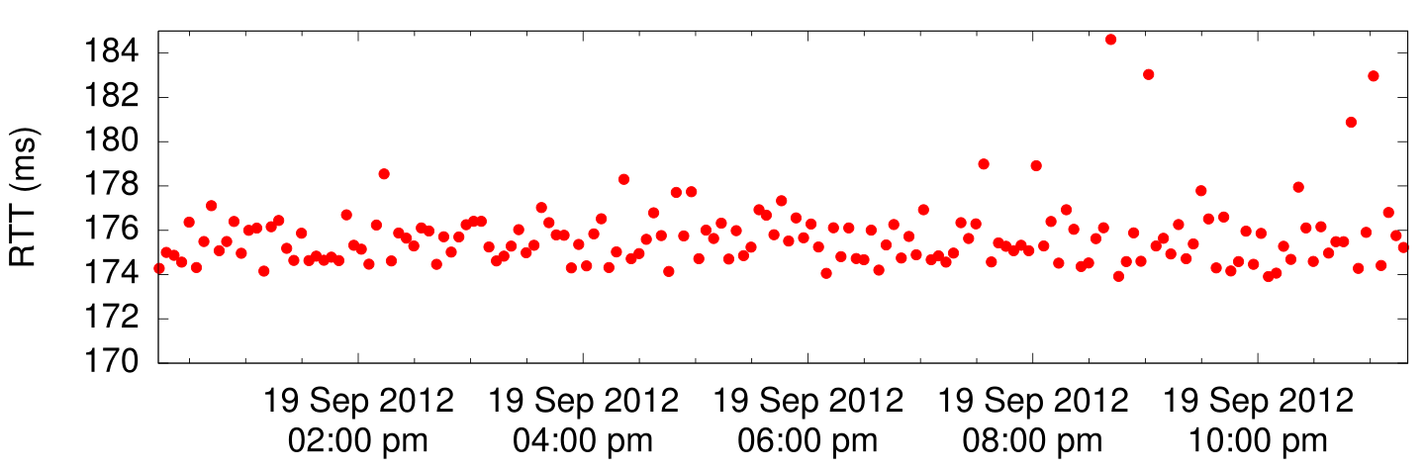
Methodology – Preprocessing
RTT Measurements | BGP updates
Ω
Periodical
Constant rate
Highly variable
On-change
Possibly bursty
Few paths
Periodical | On-change
Constant rate | Possibly bursty
Highly variable | Few paths

Slide 24

Methodology – Preprocessing
Notes:
Minimum RTT: Hernandez, A., Magana, E.: One-way delay measurement and characterization. In:
Proc. ICNS (2007)

Slide 25

Methodology – Time shift
Account for
  clock offsets
  BGP update propagation delays
    MRAI
    relative position of devices

Slide 26
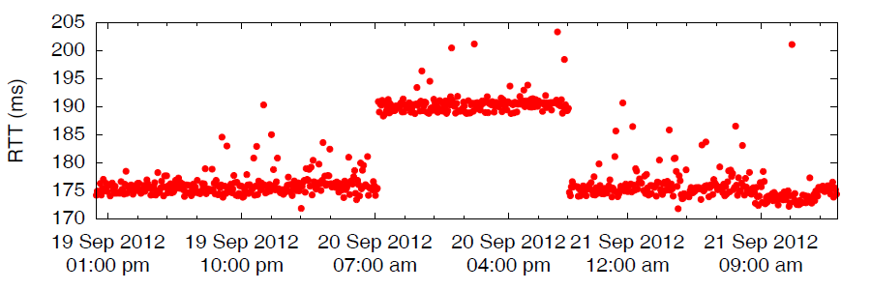
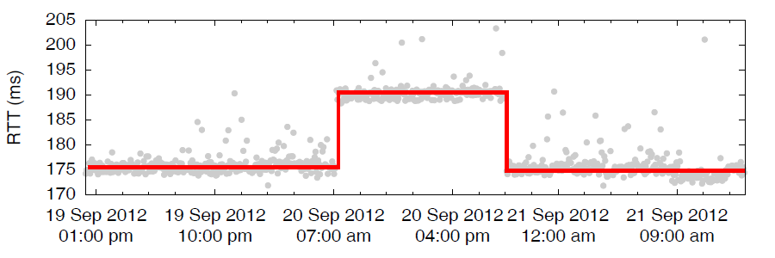
Methodology –
Changepoint detection
Goal

Slide 27
Methodology –
Changepoint detection
Technique
  Changepoint analysis statistical method(s)
  Detect mean & variance shifts in time series data
    long-lasting small changes
    short-lived significant changes
  Tunable
Pruned Exact Linear Time (PELT)
Killick, R., Fearnhead, P., Eckley, I.: Optimal detection of changepoints with a linear computational cost. Jour. Amer. Stat. Assoc. 107(500), 1590–1598, 2012
significant
shifts
Penalty
SENSITIVITY
volatile
shifts

Slide 28
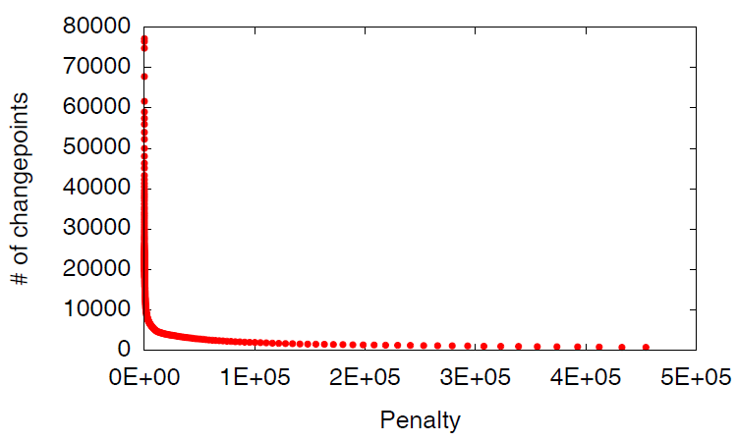

Methodology –
Changepoint detection
?
Elbow slope threshold
!
Penalty

Slide 29
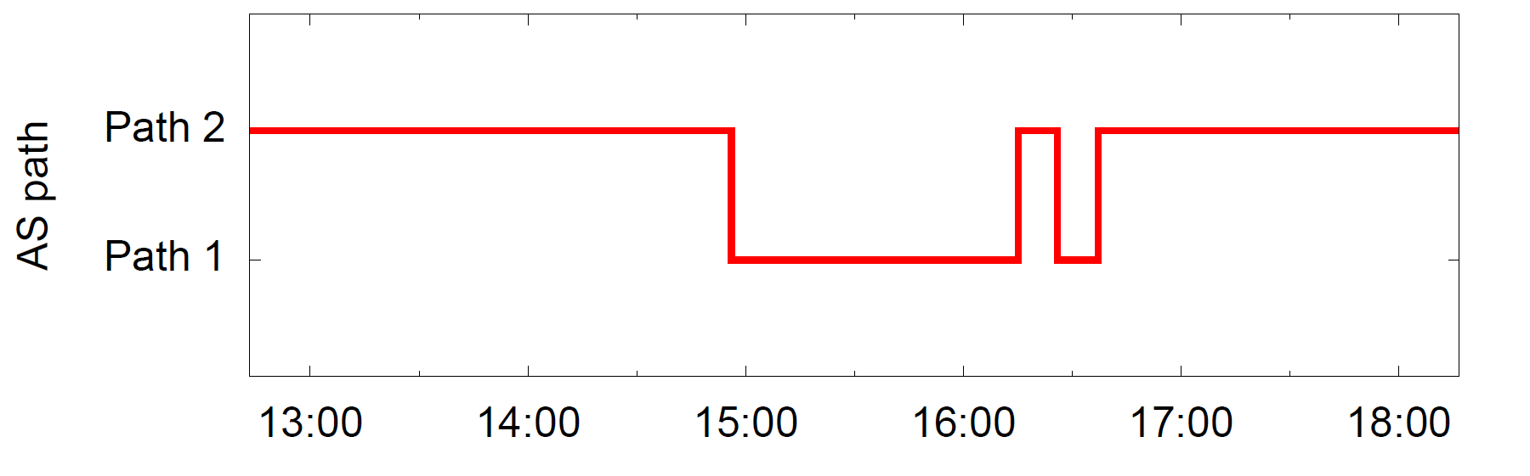
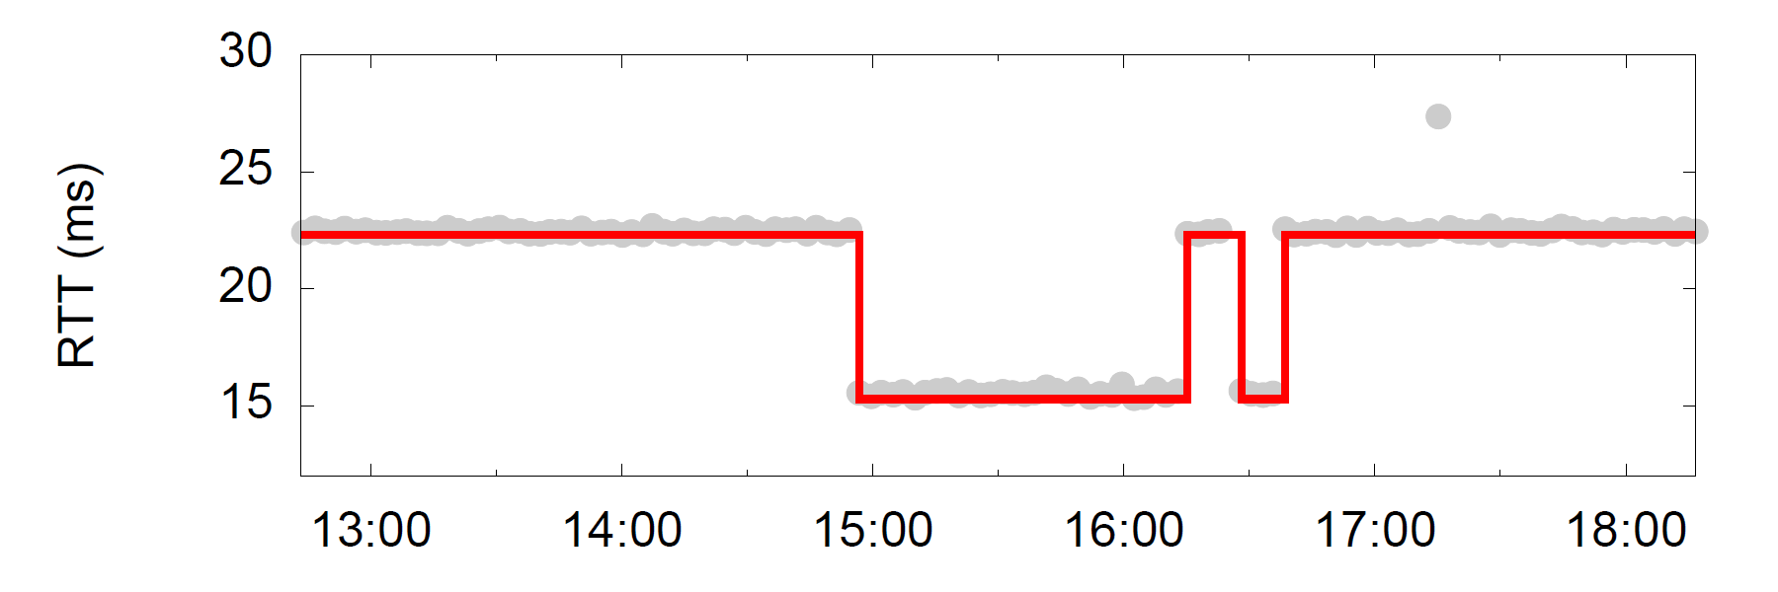
Methodology – Matching
✓
Correlated!
✓
✓
Correlated!
✓
Correlated!
Correlated!
Tolerance window
Notes:
A BGP update is “correlated” if there is at least one RTT changepoint associated with it
In subsequent analyses the start (instead of the center) of the tolerance window coincided with the time instant of the BGP update (“forwardonly”)

Slide 30
Methodology – Correlation
Correlation factor
Collector peer
Time window
Time window
Probe ID
Target
Prefix
How much are they correlated?
Raw RTT measurements
BGP updates

Slide 31

Methodology – Shortcomings
We do not account for:
  Routing changes on the
  reverse path
  RTT biases
    Clock sync
    Load balancers
    ...
Yet obtain interesting
results!

Slide 32
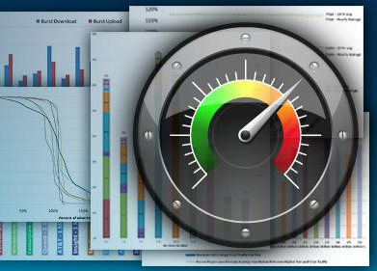










Interesting
Results
Experimental
Results
Data sources
CAIDA Archipelago
FCC Measuring
Broadband America
Route Views
MisuraInternet
SamKnows™
Ripe Atlas
RIPE RIS
M-Lab
BISMark
BGP
updates
RTT
Notes:
Project BISmark: Georgia Tech + University of Naples Federico II

Slide 33

Experimental
Results
Data sources
  Jan 2013
  footprint:
    55 ASes
    126 CPs
    200 probes
  Time window = 2 years (Jan 2011-Dec 2012)
    23 Targets
    one RTT every 4 minutes
 |  | # of probes
 |  | 1 | 2 | 3 | 4 | 5 | 7 | 13 | 22
# of CPs | 1 | 22 |  | 1 | 1
 | 2 | 12 | 3 | 3 | 2 |  |  |  | 1
 | 3 | 1 |  |  | 1 | 1
 | 4 | 1 | 1
 | 5 | 1 |  |  |  |  |  | 1
 | 6 | 1 |  |  |  |  | 1
 | 7 |  |  | 1
Ripe Atlas
RIPE RIS

Slide 34
Experimental
Results
Targets
Choice driven by... data availability!
ID | Target IP | BGP prefix | % of AS paths of len ≤5 (global avg.) | % of probes with avg. RTT ≤300ms
1001 | 193.0.14.129 k.root-servers.net | 193.0.14.0/24 (Anycast) | 87.5% | 99.5%
1003 | 193.0.0.193 ns.ripe.net | 193.0.0.0/21 (Unicast) | 87.2% | 97.3%
1004 | 192.5.5.241 f.root-servers.net | 192.5.5.0/24 (Anycast) | 57.8% | 100%
1005 | 192.36.148.17 i.root-servers.net | 192.36.148.0/24 (Anycast) | 55.5% | 99.1%

Slide 35
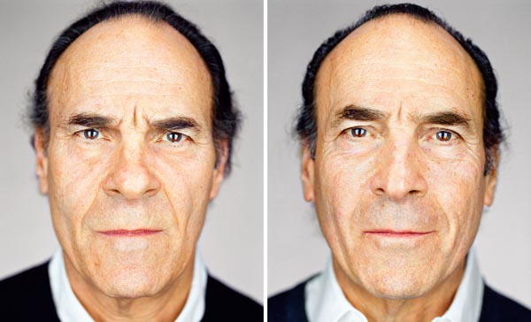

Back to Correlation
Well correlated
Find the combination of
  Time shift
  Elbow slope threshold (⇒ Penalty)
  Tolerance window
that maximizes distinction between well correlated and badly correlated data
Mr. BGP
Mr. RTT
Mr. BGP
Mr. RTT
Badly correlated
Mr. BGP
Mr. BGP
Mr. RTT
Mr. RTT
Photo ©Martin Schoeller

Slide 36
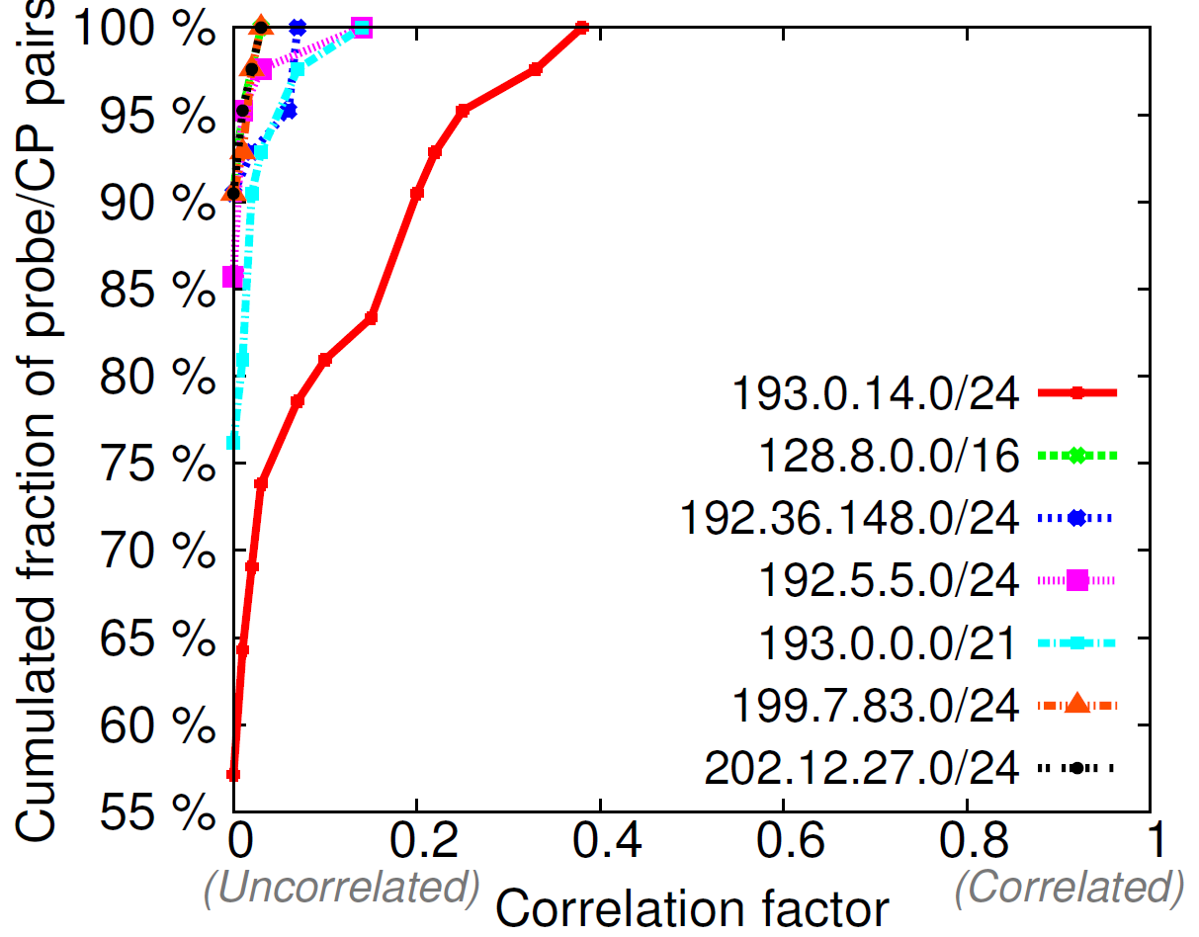
Back to Correlation
Observation: for arbitrary
    Time shift
    Elbow slope threshold
    Tolerance window
  considering a fixed
  Target and a few
  Prefixes
  (one comprising the Target)
  for all probe/CP
  pairs
  (in the same AS)
we get...
Higher cf values
Better correlation
Target: 193.0.14.129
Correlation
score
Notes:
To compare factors for different Prefixes, in the figure we only considered CPs that recorded BGP updates for all the 7 Prefixes

Slide 37
Back to Correlation
Correlation score
Independent of the specific probe and CP
Higher score ⇒ lower correlation
Collector peer
Time window
Time window
Probe ID
Target
Prefix
How much are they correlated?
Raw RTT measurements
BGP updates

Slide 38
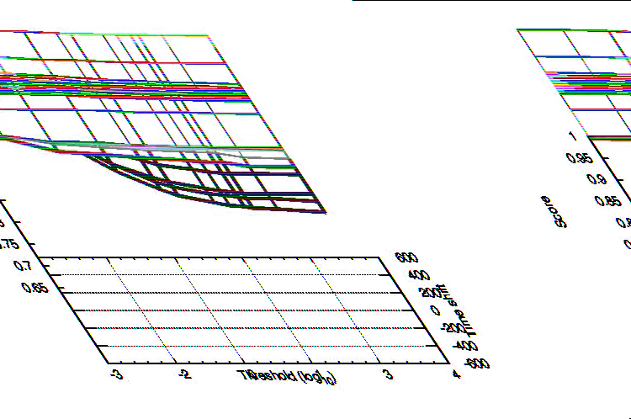
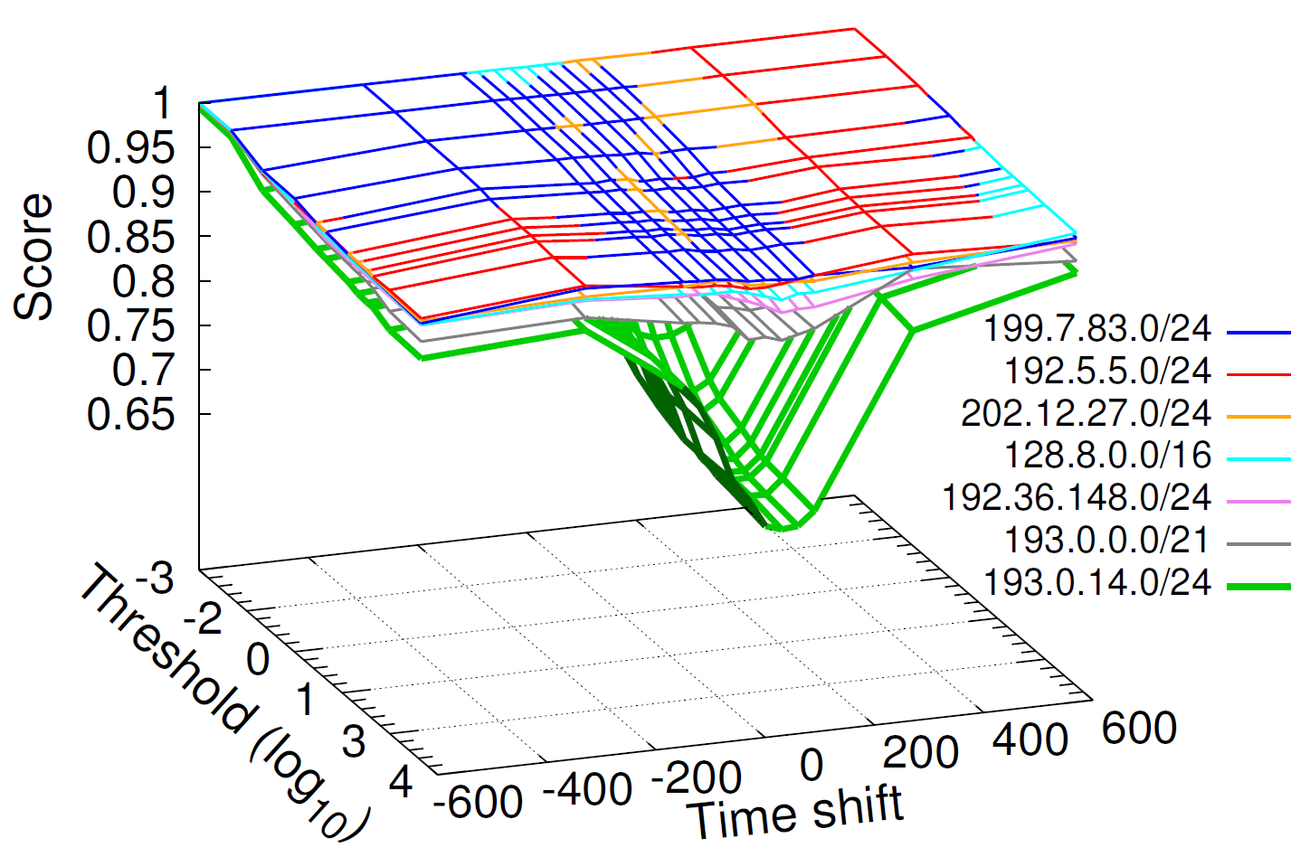
Parameter Tuning
Time shift, Elbow slope threshold
Elbow slope threshold
Penalty
# of RTT changepoints
Correlation factor(s)
Correlation score
Target:
193.0.14.129

Slide 39

Parameter Tuning
Time shift = 60s
Elbow slope threshold = 10⁴
Tolerance window = 5 mins
  Based on the rate of RTT measurements
Good for all Targets
and Prefixes!

Slide 40
Statistical Analyses
 | Measurement ID
 | 1001 | 1003 | 1004 | 1005
path-changes with consistent | 87.5% | 78.6% | 72.5% | 86.4%
path-change-pairs with | 64.8% | 52.1% | 43.3% | 68.8%
path-changes with | 76.4% | 57.4% | 64% | 80.6%
path-changes with (~same BGP change ⇒ same RTT change) | 73.6% | 75.5% | 95.5% | 93.1%
Path-change: occurrence of recorded by a CP and matched with an RTT variation seen by a probe in the same AS
Path-change-pair: occurrence of and seen by the same probe/CP pair
Notes:
Changes happening closer to the AS hosting the probe corresponded to larger average RTT variations
Fractions are referred to the number of path changes (or path-change-pairs)

Slide 41
Traceroute-based Validation
Traceroutes from RIPE Atlas
  One every 20 mins
IP→AS mapping
  Based on RIPE RIS BGP tables
BGP-RTT → BGP-traceroute
Results:
  For well correlated BGP-RTT data (high cf) there is evidence of correlation even with traceroute data
badly
low
no

Slide 42
Further Possible Analyses
Recall from the motivations
  Equivalence classes
  Placement of delay-sensitive services
  Troubleshooting
High correlation

Slide 43

Conclusions
Application (+validation) & statistics
Automated Investigation of the Impact of BGP Routing Changes on Network Delay Variations

Slide 44

Future Work
Other data sources/vantage
points/targets
Other statistical methods
  Consider noise, gaps, patterns
    Unreachability in BGP, gap in RTT: ok!
1-way performance indicators in a controlled environment
  Wi-Fi
Further analyses
✓

Slide 45

hank you!

